Slide 1
Artificial Neural Networks
Anshu Pandey

Slide 2

Agenda
Artificial Neural Networks
Introduction to Neurons
Single Neuron Model
Activation Functions
Neural Network Architecture
Types of Neural Networks
Applications, Advantages and Limitations
Single Layer Neural Network Code

Slide 3

Artificial Neural Networks
Artificial Neural Networks, in general — is a biologically inspired network of artificial neurons configured to perform specific tasks.

Slide 4
Neural networks learn from examples
No requirement of an explicit description of the problem.
No need for a programmer.
The neural computer adapts itself during a training period, based on examples of similar problems even without a desired solution to each problem. After sufficient training the neural computer is able to relate the problem data to the solutions, inputs to outputs, and it is then able to offer a viable solution to a brand new problem.
Able to generalize or to handle incomplete data.

Slide 5
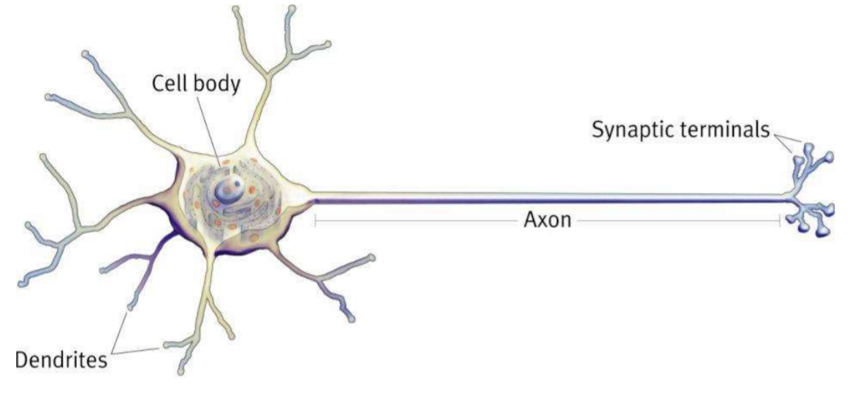
Introduction to Neuron

Slide 6

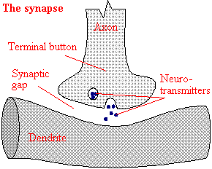
Information exchange b/w Neurons
Neurons

Slide 7
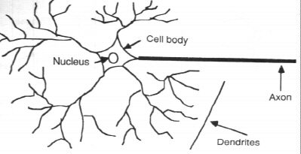
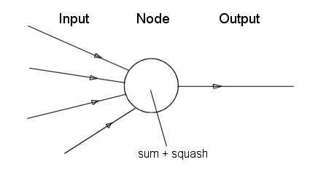
Neuron vs. Node
Neuron in Brain
A Neuron/Node in Artificial Neural Network

Slide 8
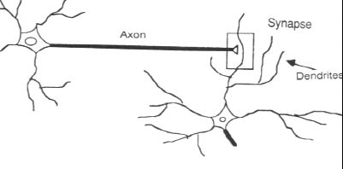
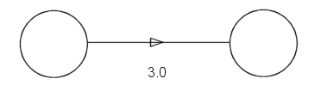
Synapse vs. weight

Slide 9
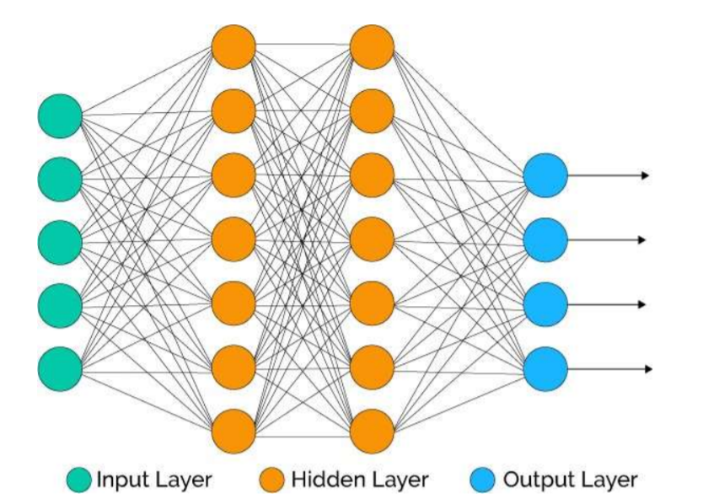
Architecture of Neural Network
A typical neural network contains a large number of artificial neurons called units arranged in a series of layers.

Slide 10
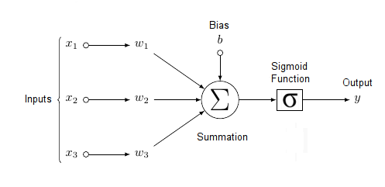
Elements of Neural Networks
1. No Computation on Input layer Neurons
2. Two process on every computational Neuron.
Weighted Sum
Activation Function
Notes:
Each neuron within the network is usually a simple processing unit which takes one or more inputs and produces an output. At each neuron, every input has an associated weight which modifies the strength of each input. The neuron simply adds together all the inputs and calculates an output to be passed on.

Slide 11
The Single Neuron Structure
Bias
b
x₁
w₁
Activation
function
Local
Field
v
Output
y
Input
signal
x₂
w₂
Summing
function
x_{m}
w_{m}
Synaptic
weights

Slide 12
Bias as extra input
w₀
x₀ = +1
x₁
w₁
Activation
function
Local
Field
v
Input
signal
Output
y
x₂
w₂
Summing
function
Synaptic
weights
Bias is an external parameter of the neuron. Can be modeled by adding an extra input.
x_{m}
w_{m}

Slide 13
Network Architecture
Three basic different classes of network architectures
Single-layer feed-forward Neural Networks
Multi-layer feed-forward Neural Networks
Recurrent Nerual Networks
The architecture of a neural network is linked with the learning algorithm used to train

Slide 14
Single Layer Feed-forward
Neural Network having two input units and one output units with no hidden layers. These are also known as ‘single layer perceptrons.
Output layer
of
neurons
Input layer
of
source nodes

Slide 15
Multi Layer Feed-forward
3-4-2 Network
Input
layer
Output
layer
Hidden Layer

Slide 16
Recurrent Network
Recurrent Network with hidden neuron(s): unit delay operator z⁻¹ implies dynamic system
z⁻¹
z⁻¹
z⁻¹

Slide 17
What are Activation Functions?
Activation Functions introduce non-linear properties to Neural Network.
There are 2 types of activation functions –
1. Linear Activation Functions
2. Non Linear Activation Functions

Slide 18
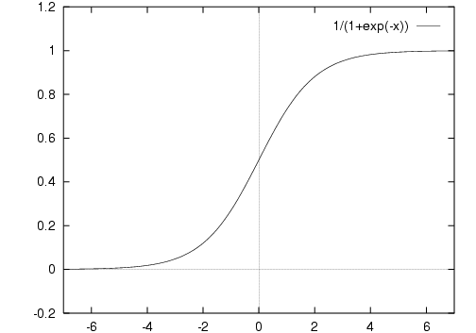

Sigmoid Function
The function is differentiable. That means, we can find the slope of the sigmoid curve at any two points.
The function is monotonic but function’s derivative is not.
The logistic sigmoid function can cause a neural network to get stuck at the training time.
The softmax function is a more generalized logistic activation function which is used for multiclass classification.
$$σ\left(z\right)=\frac{1}{1+e^{−z}}$$

Slide 19
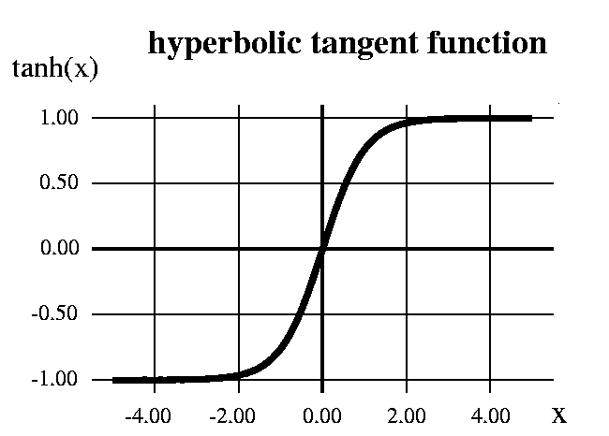

Hyperbolic Tangent function
The function is differentiable.
The function is monotonic while its derivative is not.
The tanh function is mainly used classification between two classes.
output is zero centered because its range in between -1 to 1 i.e -1 < output < 1 . Hence optimization is easier in this method hence in practice it is always preferred over Sigmoid function .
$$\tanh\left(x\right)=\frac{{1−e}^{−2x}}{{1+e}^{−2x}}$$

Slide 20


ReLu- Rectified Linear units
The function and its derivative both are monotonic.
It should only be used within Hidden layers of a Neural Network Model.
Hence for output layers we should use a Softmax function for a Classification problem to compute the probabilities for the classes , and for a regression problem it should simply use a linear function.
$$f\left(x\right)=max⁡(x,0)$$

Slide 21
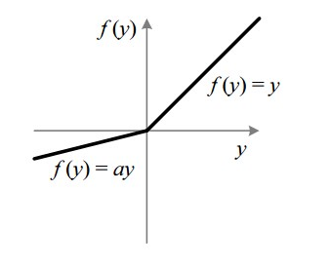

Leaky ReLu
The problem with ReLu is that some gradients can be fragile during training and can die. It can cause a weight update which will makes it never activate on any data point again. Simply saying that ReLu could result in Dead Neurons.
To fix the problem of dying neurons another modification was introduced called Leaky ReLu. It introduces a small slope to keep the updates alive.
$$f\left(x\right)=\left\{\begin{matrix}x if x>0 \\ 0.01x otherwise\end{matrix}\right\}$$

Slide 22
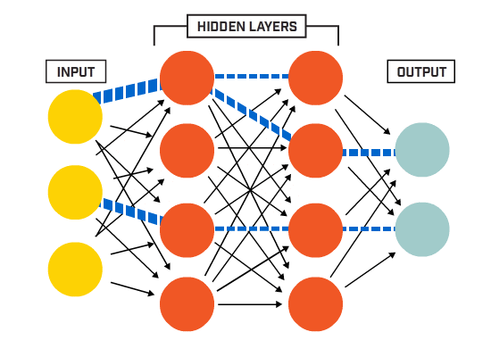
Network Architecture

Slide 23


Slide 24
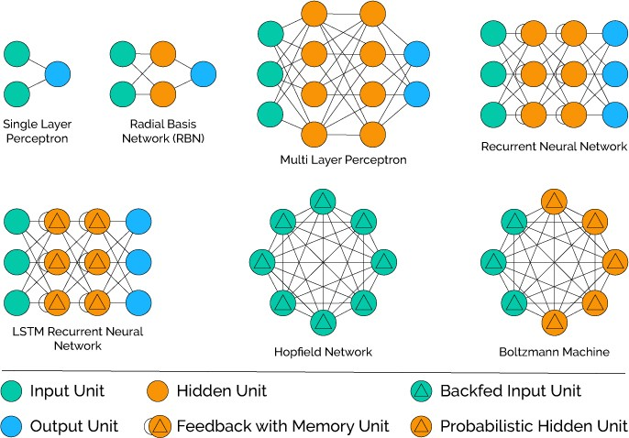
Neural Network Types

Slide 25
Neural Network for Machine Learning
Multilayer Perceptron (supervised classification)
Back Propagation Network (supervised classification)
Hopfield Network (for pattern association)
Deep Neural Networks (unsupervised clustering)

Slide 26
Neural Network for Deep Learning
Recurrent neural network
Multi-layer perceptrons (MLP)
Convolutional neural networks
Recursive neural networks
Deep belief networks
Convolutional deep belief networks
Self-Organizing Maps
Deep Boltzmann machines
Stacked de-noising auto-encoders

Slide 27
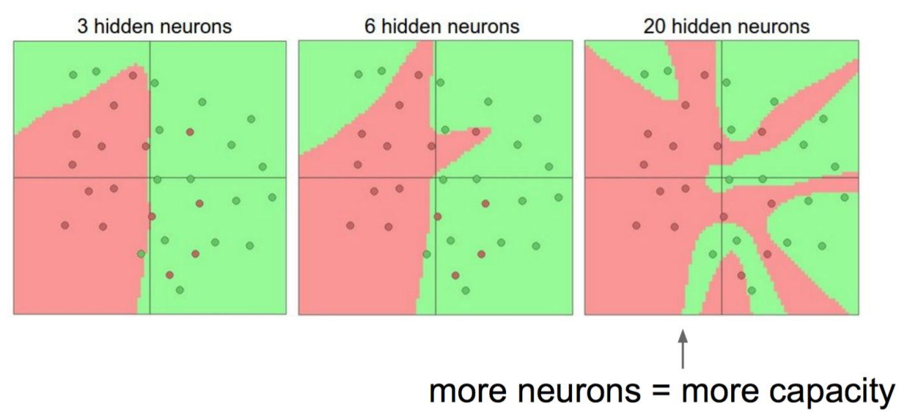
How many hidden Neurons?

Slide 28
Advantages of Neural Networks
A neural network can perform tasks that a linear program can not.
When an element of the neural network fails, it can continue without any problem by their parallel nature.
A neural network learns and does not need to be reprogrammed.
It can be implemented in any application.
It can be performed without any problem.

Slide 29
Limitations of Neural Networks
The neural network needs the training to operate.
The architecture of a neural network is different from the architecture of microprocessors, therefore, needs to be emulated.
Requires high processing time for large neural networks.

Slide 30
Applications of Neural Networks
Application | Architecture / Algorithm | Activation Function
Process modeling and control | Radial Basis Network | Radial Basis
Machine Diagnostics | Multilayer Perceptron | Tan- Sigmoid Function
Portfolio Management | Classification Supervised Algorithm | Tan- Sigmoid Function
Target Recognition | Modular Neural Network | Tan- Sigmoid Function
Medical Diagnosis | Multilayer Perceptron | Tan- Sigmoid Function
Credit Rating | Logistic Discriminant Analysis with ANN, Support Vector Machine | Logistic function

Slide 31
Single Layer Neural Network
# Single layer Neural Network
# x1,x2=,x3=1,1,1
# w1,w2,w3=0.2,0.3,0.1
# Activation function --> fx=2*x
X1=1
W1=0.2
Yhat
X2=1
W2=0.3
W3=0.1
X3=1
L1
L2

Slide 32
Single Layer Neural Network
import numpy
x=numpy.array([1.0,1.0,1.0]).reshape(1,-1)
t=numpy.array([30.0])
w=numpy.array([0.2,0.3,0.1]).reshape(3,1)

Slide 33
Single Layer Neural Network
for i in range(30):
l1=x #loading the data into the network - input layer
#weighted sum of inputs from l1 layer & weights
z=numpy.dot(l1,w)
l2=2*z #activation function
#GDA - wn=w-LR*dj/dw
djdw=(l2-t)*2*l1
w=w-0.01*djdw.T
print(l2)
print(w)

Slide 34
Thank you
Stay tuned for Model Representation and Backpropagation Algorithm

